Slide 1
INTRODUCTION TO STATISTICS

Slide 2

What is Statistics?
Statistics
It deals with collection, presentation, analysis, and interpretation of numerical data in order to make decisions.
6

Slide 3


























Data Sets
Population
The entire group of individuals is called the population. Or The group of all item that is under study.
Examples: All students studying at Abasyn University.
All the registered voters in Pak.
Sample
A subset of the population.
7

Slide 4
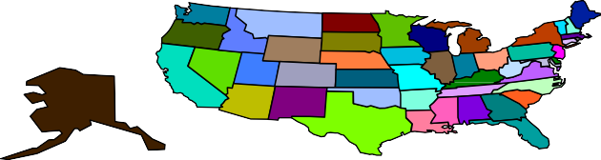
Parameter and Statistic
Parameter
A number that describes a population
characteristic. (Numerical value which summarize all the entire population)
Average age of all people in the United States or Average score of the Abasyn University students.
Statistic
A number that describes a sample characteristic. Or any numerical value which we calculate from sample is called statistic.
Average age of people from a sample of three states
11

Slide 5








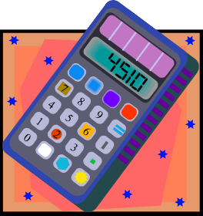



















Branches of Statistics
Descriptive Statistics Involves organizing, summarizing, and displaying data. Descriptive statistics describe the data set but does not allow us to draw any conclusion
e.g. Tables, charts, averages
Inferential Statistics Involves using sample data to draw conclusions about a population.
14

Slide 6
Variables
A variable is a characteristic or condition that can change or take on different values.
Most research begins with a general question about the relationship between two variables for a specific group of individuals.

Slide 7



Types of Variables
Qualitative Variable
Consists of attributes, labels, or nonnumerical entries.
Major
Place of birth
Eye color

Slide 8

Types of Variavles
Quantitative variables
Numerical measurements or counts.
Age
Weight of a letter
Temperature

Slide 9
Levels (Scales) of Measurement
1. Nominal level of measurement
Qualitative data only
Categorized using names, labels, or qualities
No mathematical computations can be made
2. Ordinal level of measurement
Qualitative or quantitative data
Data can be arranged in order
Differences between data entries is not meaningful

Slide 10
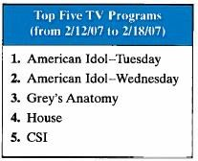
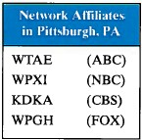
Example: Classifying Data by Level
Two data sets are shown. Which data set consists of data at the nominal level? Which data set consists of data at the ordinal level? (Source: Nielsen Media Research)

Slide 11
Solution: Classifying Data by Level
Ordinal level (lists the rank of five TV programs. Data can be ordered. Difference between ranks is not meaningful.)
Nominal level (lists the call letters of each network affiliate. Call letters are names of network affiliates.)

Slide 12
Levels of Measurement
3. Interval level of measurement
Quantitative data
Data can ordered
Differences between data entries is meaningful
Zero represents a position on a scale (not an inherent zero – zero does not imply “none”)

Slide 13
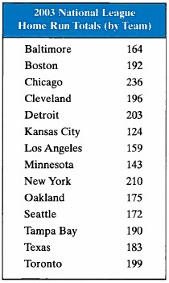
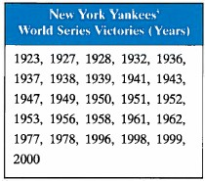
Example: Classifying Data by Level
Two data sets are shown. Which data set consists of data at the interval level? Which data set consists of data at the ratio level? (Source: Major League Baseball)

Slide 14
Levels of Measurement
4. Ratio level of measurement
Similar to interval level
Zero entry is an inherent zero (implies “none”)
A ratio of two data values can be formed
One data value can be expressed as a multiple of another

Slide 15
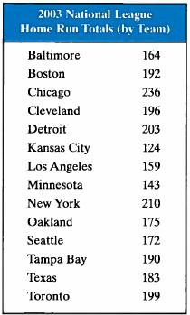
Solution: Classifying Data by Level
Interval level (Quantitative data. Can find a difference between two dates, but a ratio does not make sense.)
Ratio level (Can find differences and write ratios.)

Slide 16
Summary of Four Levels of Measurement
Level of Measuremen t | Put data in categories | Arrange data in order | Subtract data values | Determine if one data value is a multiple of another
Nominal | Yes | No | No | No
Ordinal | Yes | Yes | No | No
Interval | Yes | Yes | Yes | No
Ratio | Yes | Yes | _{Yes} | Yes ³⁴

Slide 17

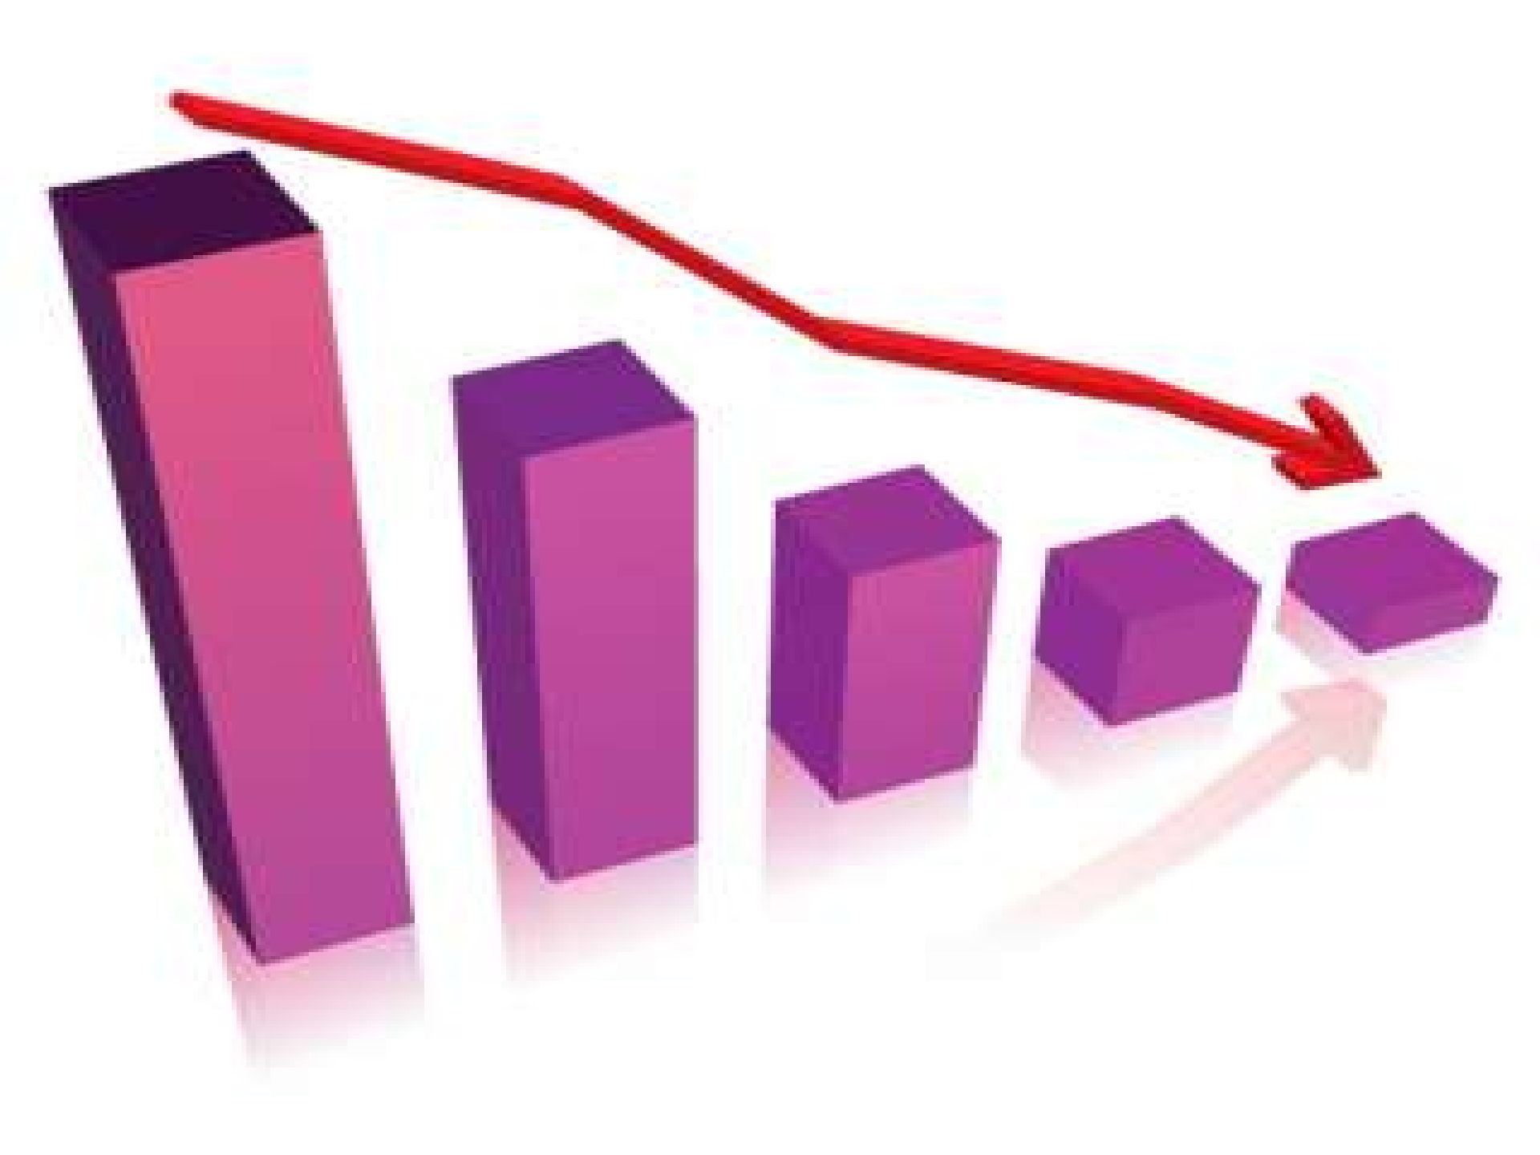



Slide 18


Data is a collection of facts, such as values or measurements.
It can be numbers, words, measurements, observations or even just descriptions of things.
adeel_tc@hotmail.com 0315-4632432

Slide 19
Primary & Secondary Data
Types of Data
Original Form of data/ no Statistical methods to be used is called primary data
Not in original form/ some statistical methods to be used is called secondary data

Slide 20
Method of collection of primary data
Direct Personal Investigation
Indirect Personal Investigation
Investigation through Questionnaire
Investigation through enumerators
Investigation through local source.

Slide 21
Method of collection of Secondary data
Government Organization
Semi- Government organization
NGO
Chamber of Commence
Research institute(Universities)

